Slide 1
The Mind-Body Problem
Introduction to Philosophy
Philosophy 100
Class 9

Slide 2

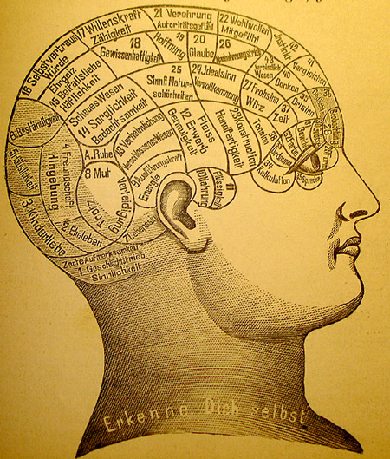
Overview
Our focus in this part of the section falls under the categories of metaphysics and philosophy of mind.
Metaphysics: a branch of philosophy investigating the fundamental nature of being and the world that encompasses it. Metaphysics attempts to answer two basic questions: Ultimately, what is there? What is it like?
This branch is concerned with ontology: the nature of being.
Philosophy of Mind: studies the nature of the mind, mental events, mental functions, mental properties, consciousness, and their relationship to the physical body

Slide 3
Ontology: an overview
Monism
Dualism
There is fundamentally only one type of stuff in the universe that everything is reducible to.
Physicalism/Materialism
Everything is just physical stuff.
Idealism
Everything is just mental stuff.
Neutral Monism
The physical and the mental are reducible to the same neutral stuff.
There are two type of things in the universe, the physical and the non-physical.
Substance
There are two substances: soul and body.
Property
There are physical properties and non-physical properties.

Slide 4

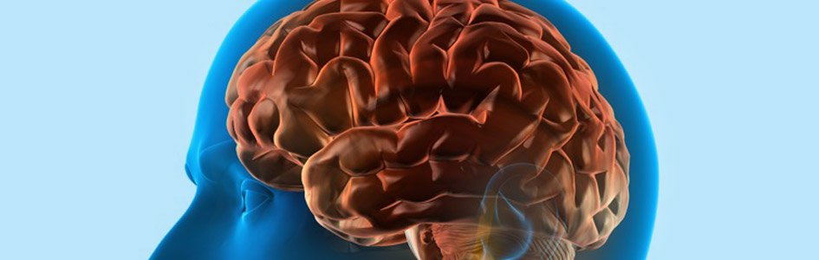
What is the Mind? Is it Distinct from the Body?
Dualism
Materialism/Physicalism
there are two entities, one physical and one non-physical—the body and the mind.
there is only one entity, and it is material, physical, stuff.
The types of things we experience do not simply seem like they are physically explainable.

Slide 5

Types of Dualism
Substance dualism
Property dualism
the mind and the body are two different substances
Cartesian Dualism
Popular Dualism
the mind and the body have completely different properties: emergent properties – properties above and beyond the explanation by physical science but emerge from physical stuff.
Epiphenominalism
Interactionist Property Dualism
Elementary-Property Dualism

Slide 6

Cartesian Dualism
Conscious reason cannot be accounted for by the mechanics of matter—the thinking thing has no spatial extension or position. We call the thing that thinks, but has no spatial extension or position the mind.

Slide 7
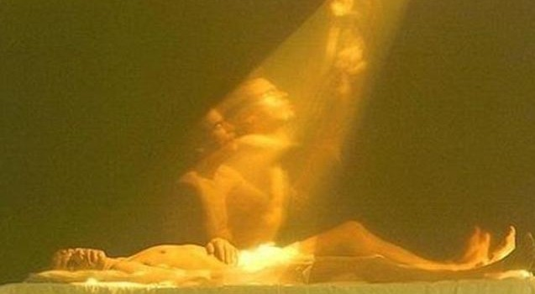
Popular Dualism
“Ghost in the machine”
There is a mind that is of utterly different stuff than our physical body. It is a spiritual substance, like a soul.

Slide 8
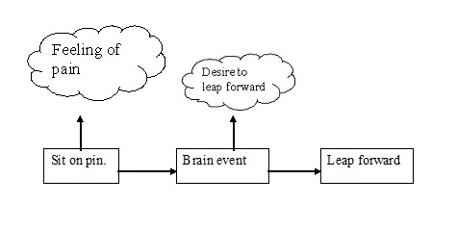
Epiphenomenalism (1-way interactionism)
The mind emerges from the physical stuff that is in the brain.
Mental Phenomena are above and beyond the physical stuff.
The physical stuff causes conscious experiences, but there is no causal effect going the other direction—the mind does not effect the physical.
(Just like the smoke that emerges from an exhaust pipe is simply the result of the engine running, but doesn’t itself cause the engine to run.)
Supervenience thesis:
There cannot be a mental difference without a corresponding physical difference.

Slide 9
2-Way Interactionist & Elementary Property Dualism
2-way Interactionist Dualism
Elementary-Property Dualism
The mind is above and beyond the body as an emergent property of the body, and it is causally efficacious.
Mental properties are not emergent, they are simply a fundamental aspect of nature—like life, or electro-magnetism.

Slide 10
Arguments for Dualism
From Religion
All major religions posit a soul.
From Real Distinction
We can conceive of the body without the mind and a mind without a body. So they must be two different things.
From Introspection
When one attends to one’s consciousness, one is not actually experiencing electro-neural workings in the brain. One is having thoughts, beliefs, emotions, and so forth
From Irreducibility
There are a variety of mental phenomena that base material cannot explain.

Slide 11

Problems With Substance Dualism
The History of Human Development
If evolution is true, then we can be nothing more than the physical stuff that we evolved from.
The Law of Conservation of Energy
If this law is true, then nothing independent of our closed system (a soul/non-physical mind) can add energy to out system
Mind-body interaction
Physical stuff causes changes in our mental life: drugs, alcohol, pain. Also, many mental events – thoughts, intentions, etc. – seem to cause our body to do things.

Slide 12

Category Mistakes
The error of assigning to something a quality or action that can properly be assigned to things only of another category
For example, suppose we look at the picture on the right and say: “I see the library, quad, gymnasium, dorms, and student center. But where is the university?
This is a category mistake.
On this view, it is a mistake to treat the mind as an object made of an immaterial substance because predications of substance are not meaningful for a collection of dispositions and capacities.

Slide 13

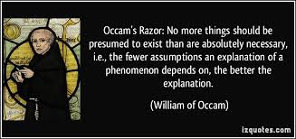
Further Problems for Dualism
Dualism lacks the simplicity offered by monistic (materialist) accounts.
Why posit two things, when one will do?

Slide 14
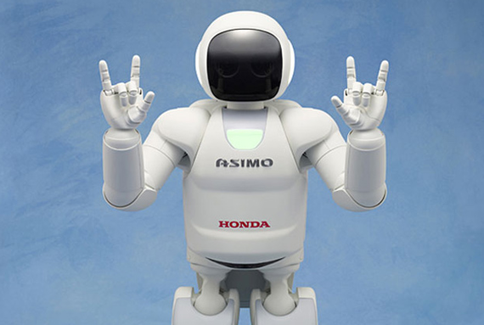
Further Problems for Dualism
Dualism is explanatorily impotent compared to physicalism.
We know the brain exists. We know what it’s made of. We know how it interacts with the body.
We can even create machines that share the types of properties dualists appeal to as irreducibly mental.

Slide 15
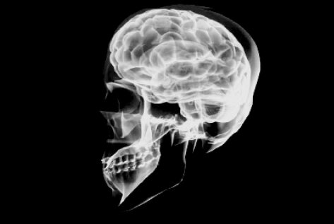
Materialism
All there is concerning the mind is physical information—there is nothing beyond the physical.
Any reference to “the mind” is simply referring to whatever physical events are taking place.
Motivations for this view:
We know what a brain is and that the brain is intricately related to things we would dub “mental experiences.” Philosophy and neuroscience can work together.
There are less things to explain away, ontologically.
Consistency with the natural order—evolution needn’t be explained away; we know that when the brain ceases functioning, a person’s mental life also ceases.
There is no interaction problem.

Slide 16

Mind-Brain Identity Theory
Mind-Brain Correlation:
Whenever we are amused, there is an increase in the electrochemical activity in a region of the brain called the inferior temporal gyrus.
Mind-Brain identity:
Feelings of amusement just are increased electrochemical activity in the inferior temporal gyrus.
The Mind = The Brain
Mental properties exist. They reduce, however, to properties of the brain.
Mental states, processes, and events correlate with, of are indentified with, physical brain states, processes, and events.

Slide 17
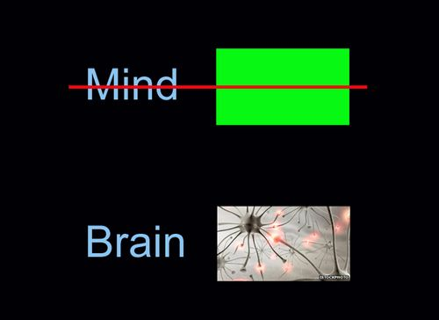
Materialist Responses to The Mental
Eliminative Materialism
Advances in neuroscience will eventually show us that that are no minds. There are brains and those things we label as mental are just convenient fictions that explain our behavior.
Beliefs, desires, thoughts, love, pain, and the like don’t actually exist—they merely adopt folk psychology.

Slide 18
What about The Mental?
Inward accessibility
Subjectivity
Intentionality
Goal-Directedness
Creativity and Freedom
Consciousness

Slide 19
The Qualia problem
Qualia
The Problem
The phenomenal information one has in experience that is beyond the mere physical information.
The subjective character of experience—the “What it’s like to…” experience.
If the world possesses qualia, then there is more information in the world than merely physical facts.
Physicalism says the only information in the world is physical facts.
The world possesses qualia.
Therefore, physicalism is false—or at least in complete.

Slide 20

Nagel’s Criticism of materialism
There is something it is like to be a bat.
There is no way we can know what it’s like to be a bat—what the subjective experiences of a bat are like.
Their perceptual mechanisms are so different from ours that even if we had all the physical information possible about bat physiology, we would still be unable to have bat experiences.
We cannot even get a rough grasp beyond our own experiences of what echolocation and sonar “vision” would be like.

Slide 21

Main Point: It is useless to base the defense of materialism on any analysis of mental phenomena that fails to explicitly deal with their subjective character.

Slide 22

KNOWLEDGE ARGUMENT
Mary has all the physical information concerning human color vision before her release.
But there is some information about human color vision that she does not have before her release.
Therefore, Not all information is physical information.
Mary knows all the physical facts concerning human color vision before her release.
But there are some facts about human color vision that Mary does not know before her release.
Therefore, there are non-physical facts concerning human color vision.

Slide 23
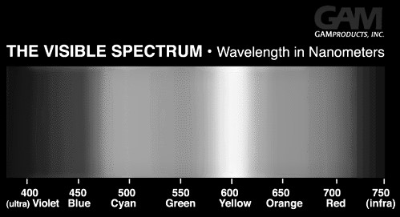
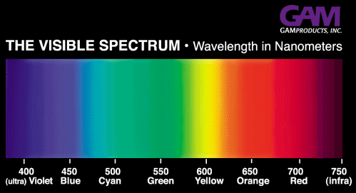
RESPONSE
“Knowing what it’s like” is not the possession of any new information at all. It is simply having new abilities—it just is the possession of the abilities to remember, imagine, and recognize.
That’s “knowing-how” not “knowing-that”

Slide 24
HELPFUL TAXONOMY
Dualism
Brain-Mind Identity
Eliminativist Materialism
The mind and mental states are real.
They are something above and beyond our physical brain states.
Realist
The mind and mental states are real.
They are physical states and events involving our brains.
Reductionist
Brains are very real things, but minds are fictional, mythological, entities.
Eleminativist

Slide 25


